Slide 1
Lab - Your First API

Slide 2
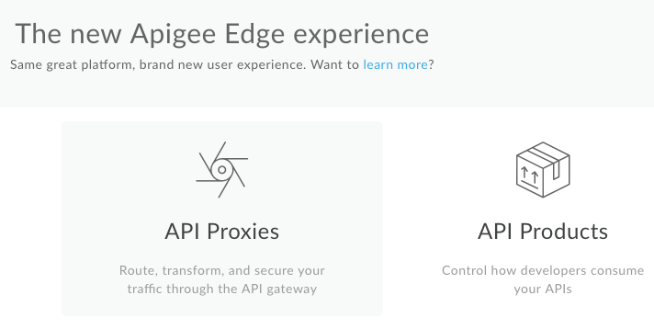
Let’s create our first API proxy
Click on API Proxies, then select +Proxy in the far right

Slide 3
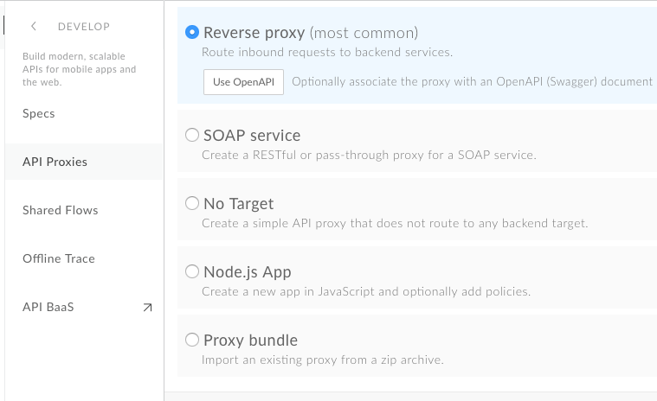
Choose your starting point
Select the Reverse proxy option
Click Next
Notes:
Backend Service / Reverse Proxy
The most common starting point
The Backend Service URL defines the target URL that Apigee Edge invokes on a request to the API proxy.
Node.js
New Node.js
Will create a simple node.js API Proxy with one of two examples. A Hello World Example or a Sample that shows how to integrate your node.js application with Apigee BaaS.
Existing Node.js
A mechanism that works like the API Bundle option for node.js applications.
SOAP / WSDL
When you are working with web-services that are defined with a WSDL you have a couple options available to help you either manage your Service as a SOAP API or an option to generate some sample REST to SOAP conversion polices.
No Target
The No Target Proxy is the simplest starting point.
This proxy can be used as an API stub
Can be also used for creating endpoints that end at Apigee
E.g. Authentication endpoints managed by Apigee for token generation
API Proxy Bundle
The API Bundle starting point allows you to import an existing API Proxy
A great way to move bundles from one org to an another.
API Bundle is a zip file

Slide 4
Enter the information below for “Reverse Proxy”
Use OpenAPI specification
Set the Backend Service URL to:
https://apibaas-trial.apigee.net/ssvaidyanathan/labs01
In the Name use something unique to you, for instance: "retail-<yourInitials>"
In the Project Base Path: use an unique path like: "/retail/v1"

Slide 5
Test your proxy
click [Next] then:
Authorization ◉ Pass Through (None)
Accept all defaults
click [Build & Deploy]
Test it
Send a request (curl, trace, console, postman, etc.) to
http://<your-orgname>-test.apigee.net/retail/v1/categories
Expect a 200 OK
Sample output below:

Slide 6
Test your proxy
Sample output below:
{
"action": "get",
"application": "907164a8-02fa-11e8-a836-122e0737977d",
"params": {},
"path": "/categories",
"uri": "https://apibaas-trial.apigee.net/ssvaidyanathan/labs01/categories",
"entities": [
{
"uuid": "91d27b28-02fa-11e8-a836-122e0737977d",
"type": "category",
"name": "Home",
"created": 1517013584637,
"modified": 1517013584637,
………………...

Slide 7
THANK YOU

